Slide 1
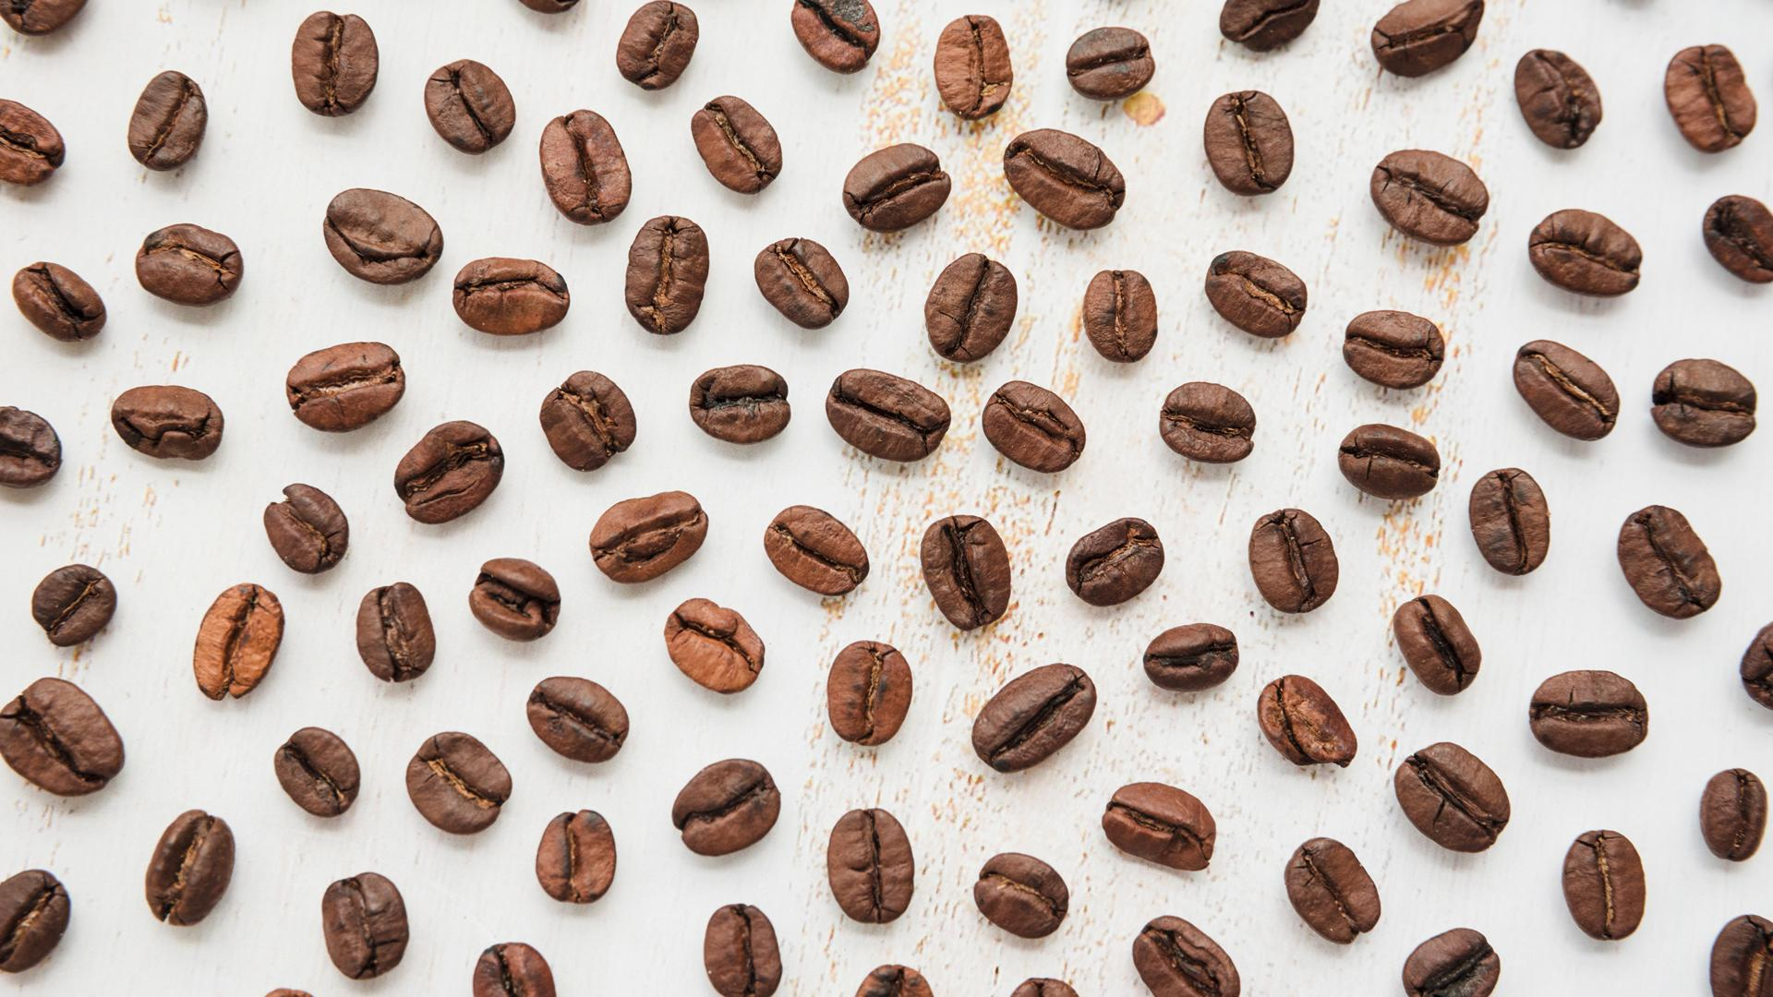
Coffee Shop
Findings and Recommendation

Slide 2


37,3 m
58,19%
$ 115.000.000
Business Problem
wasted products in a month
Compared to total daily stock
Lost Estimation
(Specialty Coffee Association study
with 6.8% margin)

Slide 3

How to Solve?
1. Increasing Sales
2. Optimaizing Stock

Slide 4

Method : Crisp - DM
Step 3
Step 2
Step 4
Step 1
Step 5
Problem discovery
Define problem statement
Get some findings and key takeaways
Define staekholder and analytics objectives
insight and recommendation

Slide 5


Step 1
Define staekholder and analytics objectives
Stakeholders
Head of Inventory & Head of Marketing
Objective
Reduction of loses due to waste products

Slide 6
Step 2
Define problem statement
58.19% of total daily stocks wasted

Slide 7
Step 3
Problem discovery
Increase Sales by maximizing marketing strategies
What is the relationship between consumer age/generation and product selection?
What is the relationship between consumer age/generation on purchase frequency?
Is there any correlation between total loyalty carda and buying frequency?
What are the most sold products in each outlet?
Inventory optimization
Can waste be reduced? If yes, How?
Are there differences in the proportion of waste contribution in certain product groups or outlet groups?
How much potential savings can be made after reducing waste?

Slide 8

Findings

Slide 9

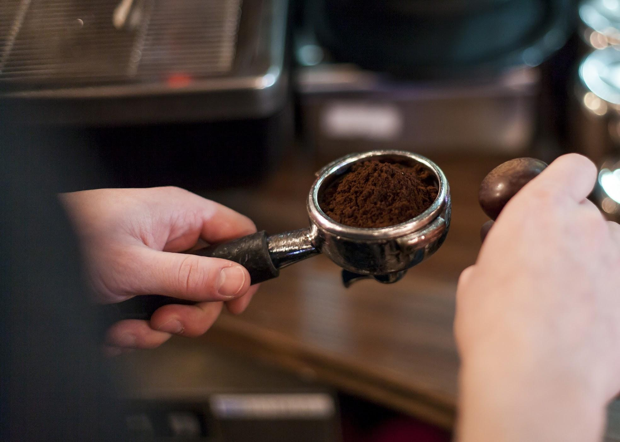
Insight and Recommendation
Recommendations
Insights
Doing promotions in the hours before the store closes
Trying to get new customers
Doing sales of Ouro Brasileo at Astoria Outlets
Utilizing previous trend data to predict the number of product purchases
The products that sell best in every outlet and in every generation tend to be the same
There are no promos at the beginning of the month and tend to increase in the middle of the month
All transactions in the given period done by customers with loyalty cards
The percentage of wasted products is relatively fixed every day for each product and outlet
There is a big gap between the daily stock quantity and the number of products sold on that day

Slide 10

Thanks!

